Slide 1
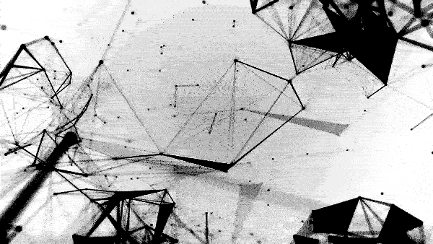



MUSIC ON THE
BLOCKCHAIN
A CRASH COURSE TO THE
ETHEREUM BLOCKCHAIN FOR MUSICIANS

Slide 2
HAVE
YOU INSTALLED
METAMASK?
Notes:
There are no stupid questions
Raise your hand

Slide 3
PLEASE
ASK
QUESTIONS
Notes:
There are no stupid questions
Raise your hand

Slide 4
FEEL FREE TO
CONTRADICT US
Notes:
We are here to share informations and improve together
No Podium

Slide 5
BLOCKCHAIN
CAN BE A COMPLEX
SUBJECT.
Notes:
I will run this first part of the course which is dedicated to my personal experience as a musician going crypto.
Blockchain is a complex subject. Everyone talks about blockchain, bitcoin, ethereum, but do we really know what it is about?

Slide 6
MUSIC
CAN ALSO BE A VERY
COMPLEX SUBJECT.
Notes:
Music is the only industry based on an immaterial, invible content
lightweight, has social impact
compared to images and movies, allows multitasking (you listen to music while running, working, shopping, cleaning).
Copyright and royalties system connected to publishing is one of the oldest system (Mozart)

Slide 7

E.G. COMPLEXITY OF AUDIENCES TODAY
Listen for free _
Take Ads _
Give personal data _
FREE
LISTENERS
Subscribe to Premium _
Buy physical copies _
Do not take Ads _
Give data _
PAYING
LISTENERS
Buy the artist’s products and merch _
Actively promote the artist on Social Media _
FANS
Create and monetize on artist-inspired content (e.g. cover bands, youtubers etc) _
EMULATORS
Organizations of Fans _
Actively work for the artist _
Produce content and events _
Receive special recognition from the artist _
FANCLUBS
Notes:
Innovating in music means being aware of all the pieces we have on the chessboard, what their value is and what actions and strategies they can implement

Slide 8
WHAT IS MUSIC MADE OF?
~ Type your answer in chat ~

Slide 9
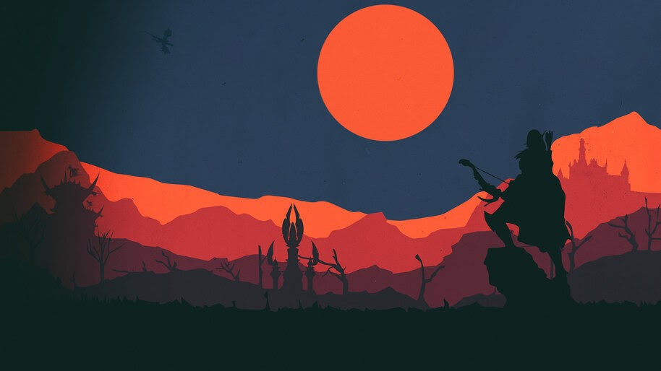
ELEMENTS IN MUSIC
Manufacturers _ Musicians _
Middle-men _ Audiences _
Third Parties _
TRIBES
Patents _
Copyrights _ Royalties _
Physical and Digital formats _ Tickets _
Numbers _
ASSETS
Devices _ Services _
TOOLS
Online _
Offline _
SPACES
Production _
Promotion _
Logistics _
Performance _
Feedback _
Curation _
ACTIONS
Notes:
TRIBES
Instruments Manufacturers and Software houses, Retail (thomann, Amazon)
Musicians: session musicians, singer-songwriters (bands, solo artists, collectives), teachers
Middlemen: studios, videomakers, management, booking agents, labels, distributors (tunecore, distro)
Third Parties: Instrument brands, merchants on YT/Spotify, purchasers of data
ASSETS:
(...) Numbers: streams, followers, concert-goers
SPACES:
Online: aggregators / streaming platforms, youtube, twitch
Offline: Live venues
INTERACTIONS
One to one: musicians and management/venue
One to many: Musician/band to fans
Many to Many

Slide 10
PRE NAPSTER
MUSIC ECONOMY
(1900s - 1999)
Notes:
In order to be able to understand what the blockchain can offer to music professionals, we must analyze some aspects in the history of music industry.
In fact, some concepts we may want to apply to music on the blockchain might derive from past examples.
So the first historical block I decided to call it “Pre Napster” WHY? Because I could have divided analog music from digital music, but when we consider CD in the 90s we are talking about digital music supports that are still marketed in the analog industry (physical copies, shops etc.)
WHY “ECONOMY” AND NOT “INDUSTRY” → Industry too often does not take into account the Immaterial Value, Economy does.

Slide 11



PRE NAPSTER
MUSICAL CONTENT
 | IMMATERIAL | MATERIAL
SUPPORT | RADIO (FM, AM) | RECORDS (LPs, MCs)
COST | FREE | PRICE
TAXATION (COPYRIGHT) | YES | YES
ADVERTISING | YES | NO
AVAILABILITY | PALIMPSEST | ON DEMAND
DUPLICABILITY | LO-FI ANALOG | HI-FI ANALOG
THIRD PARTIES | PLUGGERS | DISTRIBUTORS

Slide 12


PRE NAPSTER MUSIC ECONOMY
COSTS
EARNINGS
MIDDLEMEN
CREATORS
STUDIO
AUDIENCES
INSTRUMENTS
PROMO
SPACES
AUDIO DEVICES
SUPPLIERS
SKILLS
COPIES
GENERAL COSTS
ALBUM PRICE
GENERAL COSTS
LOGISTICS
TOUR
CACHETS
TICKETS
INSTRUMENTS
COPYRIGHTS
ROYALTIES
TICKET FEES
COPY OWNERSHIP
AUDIO DEVICES
ROYALTIES
TICKET FEES
BAR / MERCH
LIVE EXPERIENCE
CACHETS
AFFILIATION
Notes:
MIDDLEMEN
→ STUDIO: studio were generally unaffordable, so it was usually on the MGMT (until the band could pay themselves)
“RADIO? IS IT A MIDDLE MAN OR SPACE” Question

Slide 13
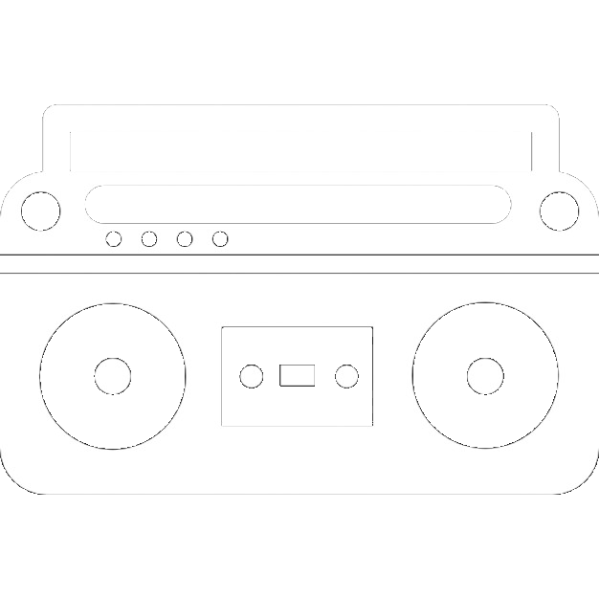

PRE NAPSTER MUSIC PIRACY
MIXTAPES
PIRATE COPIES
FOR SALE
PHYSICAL ITEMS
TIME INTENSIVE (COPYING WHILE PLAYBACK)
ALLOWS MUSIC SWAPPING
AUDIO LOSS AT 2ND GENERATION COPYING
HELPS BROADENING THE FANBASE
SCALABILITY REQUIRES CAPITAL
Notes:
Why we look at Piracy?
Piracy is something the Industry looks at very carefully: they shut down whoever might get too big, but never kill the movement.
Records always display “copying is a copyright infringement”, the audio technology market is based on copying (tape decks, blank Cassettes for mixtapes etc).
DJs needed to have authenticated copies, they could not play pirate cds or compilations.

Slide 14
DO YOU MISS THE OLD DAYS?
Notes:
Open question time

Slide 15
SHARED MUSIC ECONOMY -
WEB1 AND NAPSTER
(1999-2001)

Slide 16




THE NAPSTER MODEL
CENTRAL
INDEX
SERVER
NAPSTER CLIENT
NAPSTER CLIENT
“I’ve got it!”
Query: Roxanne.mp3
NAPSTER CLIENT
Your computer
NAPSTER CLIENT
Notes:
Napster model is fundamental to understand 2 things:
The web we browse today, made of free content
Shared databased (more for blockchain purpose)
If you logged into the old Napster to download a song, here's what happened:
You started the Napster software on your machine. Your machine became a small server able to make files available to other Napster users.
Your machine connected to Napster's central servers. It told the central servers which files were available on your machine. So the Napster central servers had a complete list of every shared song available on every hard disk connected to Napster at that time.
You typed in a query for a song. Let's say you were looking for the song "Roxanne" by The Police. Napster's central servers listed all of the machines storing that song.
You picked a version of the song from the list.
Your machine connected to the user's machine that had that song, and downloaded the song directly from that machine.
The creator of Napster had a couple of reasons for this approach:
Napster eventually grew to have billions of songs available. There is no way a central server could have had enough disk space to hold all the songs, or enough bandwidth to handle all the requests.
Napster was trying to take advantage of a loophole in copyright law that allows friends to share music with friends. The legal concept behind Napster was, "All of these people are sharing the songs on their hard disks with their friends." The courts did not agree with that logic, but it gave Napster enough time to prove the concept and grow to massive size.

Slide 17

THE NAPSTER MODEL
Notes:
Why Napster was so popular?/ because it allowed on the internet something that was there for a long time in schools, neighborhoods and concert venues: MUSIC SWAPPING

Slide 18

DIGITAL PIRACY
DIGITAL MUSIC PIRACY IN WEB1
ORIGINAL /
COPY /
COMPILATION
COPY /
COMPILATION
TIME EFFICIENT
BEGINNING OF IMMATERIAL MUSIC
NO AUDIO LOSS AT 2ND GENERATION COPYING
DEVALUATION OF SINGLE ITEM
SCALABLE WITHOUT CAPITAL
FROM OFFLINE SWAP LOCATIONS TO ONLINE
ALLOWS MUSIC SWAPPING

Slide 19
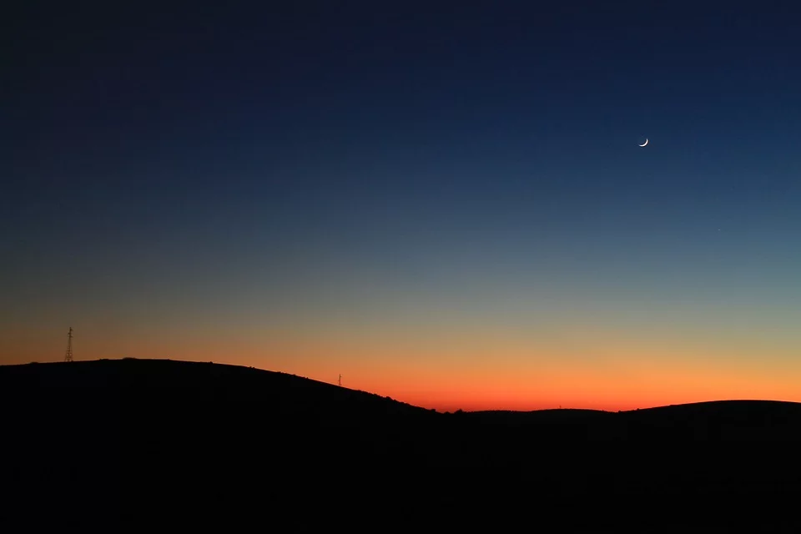

WEB1 MUSICAL CONTENT
 | IMMATERIAL | MATERIAL
SUPPORT | MP3 | CDs
CONTENT | FREE | PAID
TAXATION (COPYRIGHT) | NO | YES
ADVERTISING | NO | NO
AVAILABILITY | ON DEMAND | ON DEMAND
QUALITY | LOW (DIGITAL) | HIGH (DIGITAL)
DUPLICABILITY | 1 : 1, T=0 | 1 : 1, T>0
THIRD PARTIES | P2P | DISTRIBUTORS

Slide 20

WEB1 - DIGITAL MUSIC ECONOMY
COSTS
EARNINGS
FADING
AUDIENCES
MIDDLEMEN
CREATORS
STUDIO
HW / SW
INSTRUMENTS
PROMO
SPACES
AUDIO DEVICES
SUPPLIERS
HW / SW
COPIES
GENERAL COSTS
ALBUM PRICE
GENERAL COSTS
SKILLS
TOUR
CACHETS
TICKETS
INSTRUMENTS
COPYRIGHTS
ROYALTIES
TICKET FEES
COPY OWNERSHIP
HW / SW
ROYALTIES
TICKET FEES
BAR / MERCH
FREE DIGITAL COPIES
AUDIO DEVICES
RECORDINGS
INDEXES
LIVE EXPERIENCE
CACHETS
AFFILIATION
ONLINE
COMMUNITY
Notes:
WHERE DO WE PUT NAPSTER??
→ SPACES, BECAUSE PEOPLE INTERACT

Slide 21
ASSIGNMENT:
5 THINGS WE HAVE WE LOST WITH MP3s
5 THINGS WE HAVE GAINED WITH MP3s
Notes:
BEFORE WE START WITH MUSIC ON THE WEB2 (CURRENT) i WOULD LIKE YOU TO DIVIDE IN GROUPS OF 2, 3 AND DISCUSS THIS

Slide 22
STREAMING PLATFORMS
MUSIC INDUSTRY - WEB2
(2000s)

Slide 23

NAPSTER SHUT-DOWN
Notes:
__1999: __The Recording Industry Association of America sues Napster. The rules are about to change.
So, the RIAA sued Napster and all of its financial backers in federal court in San Francisco. The outcome eventually defined the rules of online, peer-to-peer file sharing networks.
The case dragged on for almost eight years.
A federal judge and an appeals court in San Francisco both ruled in 2002 that Napster was liable for contributory or vicarious copyright violations, because it was allowing millions of users to download music for free. Napster eventually shut down and went bankrupt, later re-emerging as a legitimate, online music service.
the case mutated into a cannibalizing feeding frenzy: The music industry was searching for deep financial pockets, and targeted one of its own.
With a bankrupt Napster unable to cough up big financial damages, the industry turned to the transnational German media conglomerate Bertelsmann. The lawsuits accused Bertelsmann of copyright infringement for propping up Napster financially with loans totaling $85 million. The lawsuits claimed the firm wanted "to preserve Napster’s user base for Bertelsmann's own commercial advantage."
At the time of the loans, Bertelsmann’s chairman, Thomas Middelhoff, explained that "Napster has pointed the way for a new direction for music distribution, and we believe it will form the basis of important and exciting new business models for the future of the music industry."
Bertelsmann paid millions of dollars to settle the claims. The media concern agreed in 2006 to pay the world’s largest label, Universal Music Group, $60 million to settle the allegations. EMI got an undisclosed amount in 2007, and Warner Music Group settled that same year for $110 million.
The Napster case closed its final chapter in August 2007, when Bertelsmann agreed to pay the National Music Publishers Association $130 million to settle the remaining copyright claims.
The case also served as the impetus, in part, for the RIAA's litigation campaign against individual users, as the industry could not keep up a legal game of Whac-A-Mole against flourishing file sharing services like Kazaa and Limewire. In the last six years, the RIAA has filed about 30,000 copyright cases against individuals, most of whom have settled out of court.

Slide 24




NAPSTER FIRST AFTERMATH (2001-2003)
GNUTELLA (AOL- Microsoft)
KAZAA
LIMEWIRE
→ $ 0.99 / song
Free Content
Anonymous
No Social
Metadata (IP)
No Advertising
Not Safe (viruses)
Paid Content
No Social
Metadata (Sync → cloud)
No Advertising
Safe
Free Hosting
Authentication
Social
General Advertising
Safe
Notes:
GNUTELLA (somehow a case study for Data Collection)
There is no central database that knows all of the files available on the Gnutella network. Instead, all of the machines on the network tell each other about available files using a distributed query approach.
There are many different client applications available to access the Gnutella network.
The original Napster had one piece of "client software" -- the software that users ran on their machines to access the Napster servers. Gnutella has dozens of clients available. Some of the popular Gnutella clients include:
BearShare
Gnucleus
LimeWire
Morpheus
WinMX
XoloX
iPOD
iPOD and Music was used as a case study for the iPhone (see General Magic)
It created the first IOT ecosystem: iPOD could sync with your computer, with external Audio devices
Syncing → Mac iCal or Microsoft Outlook/Outlook Express + Third Party softwares installed

Slide 25




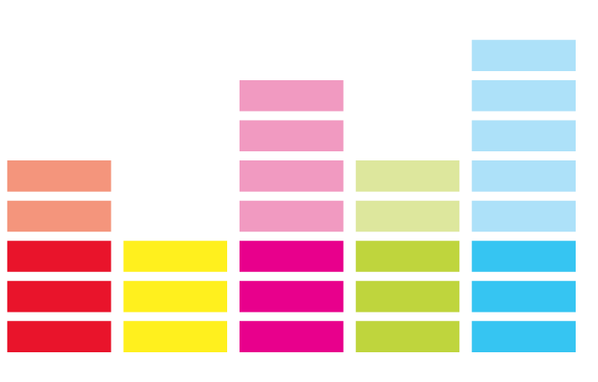






NAPSTER SECOND AFTERMATH (2004-2020)
The rise of Sharing Economy Platforms (WEB2)
Free Content
Authentication
Social
Metadata
Ads/Premium
Safe
Free Hosting
Authentication
Social
Metadata
Personal Advertising

Slide 26


FROM WEB1 to WEB2
WEB 1
WEB 2
INDEX
SERVERS
Notes:
BIT MORE CLARITY ON PRIVATE NETWORKS OWNERSHIPS

Slide 27

WEB2 MUSICAL CONTENT
 | IMMATERIAL | MATERIAL
SUPPORT | STREAM | MP3/CDs/Vinyls
CONTENT | FREE/PREMIUM | P2P/BUY
TAXATION | DATA | YES
ADVERTISING | YES | NO
AVAILABILITY | ON DEMAND | ON DEMAND
QUALITY | UPON PREMIUM | HIGH
DUPLICABILITY | NOT SERVED | YES
THIRD PARTIES | MERCHANTS/DATA | DISTRIBUTORS

Slide 28
WEB2 - STREAMED MUSIC ECONOMY
OUT
IN
AUDIENCES
FADE
CREATORS
AUDIO DEVICES
INSTRUMENTS
MIDDLEMEN
SPACES
HW /SW
HW / SW
PROMO
LICENSES
DATA
SUPPLIERS
STUDIO
COPIES
GENERAL COSTS
PREMIUMS
GENERAL COSTS
SKILLS
TOUR
FEE CUT
TICKETS
INSTRUMENTS
COPYRIGHTS
ROYALTIES
TICKET FEE / PREMIUM
ENDLESS CONTENT
HW / SW
ROYALTIES
TICKETS
THIRD PARTIES
LIVE EXPERIENCE
AUDIO DEVICES
RECORDINGS
METADATA
AFFILIATION
CACHETS
ONLINE
COMMUNITY
INFLUENCING
INFLUENCING
Notes:
SPOTIFY ?? is it A MIDDLEMAN OR IS IT A SPACE

Slide 29
RESUME - MUSICIAN BUSINESS MODEL TODAY
PROFIT
MANUFACTURERS
AGGREGATORS
SERVICES
CMO
DISTRIBUTORS
AUDIENCES
CONTENT
MUSICIANS
LOSS
Notes:
TO BE WORKED OUT →. CONCLUSIONS

Slide 30

GATE-KEEPERS
MUSICIANS
AUDIENCES
Notes:
THIS IS WHERE WE START TALKING ABOUT BLOCKCHAIN

Slide 31
WEB 3

Slide 32
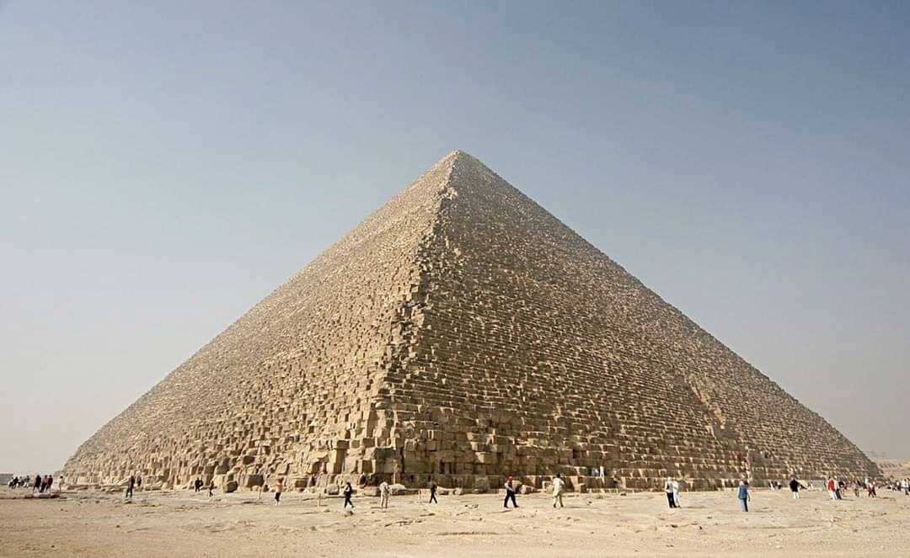
WEB 2.0
(CENTRALIZED PLATFORMS)
Singular
Full of Value
An easy target
Notes:
Pyramid is like the web2:
There was a fire at the French server company OVH - how many websites data was burned?
In terms of security - a bank’s database is like a pyramid - sitting there with a lock on the door - like a pyramid. If you can break the lock you get the money or the information.

Slide 33
WEB 3
BLOCKCHAIN TIMELINE
1990s
Birth of the Internet Distributed computing
Nick Szabo’s Smart contract
2009
Satoshi Nakamoto Bitcoin Whitepaper Decentralized ledger.
2014-2016
Ethereum launches. First financial apps and smart contracts. ERC20 Token Standard
2019-2021
Ethereum Layer-2 R&D
ERC721 (NFT)
DeFi
2008
The global financial crisis triggered by the subprime bubble exposes the flaws of a non-transparent financial system.
2011-2013
Deployment of other cryptocurrencies.
Vitalk Buterin publishes the Ethereum Whitepaper.
2016-2018
Dapps
Stablecoins
ICO
Governance Tokens
Notes:
2008 crisis - causing people to not trust the financial system
2009 bitcoin
2013 Vitalik’s Ethereum whitepaper builds on Bitcoin but adds computing power to the blockchain - so it is both a leger saving info and a computer processing info.
2014 Ethereum launches

Slide 34
FUNDING EVOLUTION
Traditional
Kickstarter Model
WEB3 / Crypto
Corporate/
Startup
Corporate/
Startup/
Small time
Corporate
STOCK MARKET
EQUITY CROWD
FUNDING
ICOs
DEFI
Startup
ANGEL INVESTOR
Small Time
Small Time
FRIENDS & FAMILY
CROWD
FUNDING
Notes:
Small time project - ask your aunt.
DIFFERENCE BETWEEN ICO AND DEFI
ICO → I buy equities on-chain (stock market open to everyone)
DEFI → on blockchain there are no banks, where do I put my money to generate interest? There are different solutions.
DeFi allows people to store their cryptocurrencies and generate interest. An On-chain company might run a similar
Service and pay back stakers with equities.
DeFi allows exchange between tokens

Slide 35
VOCABULARY
→ NODES
→ ETHER
→ ADDRESSES
→ SMART CONTRACTS
→ TOKENS (Fungible ERC20; NFT ERC721; SFT ERC1155)
→ ICO
→ DEFI
→ L2

Slide 36
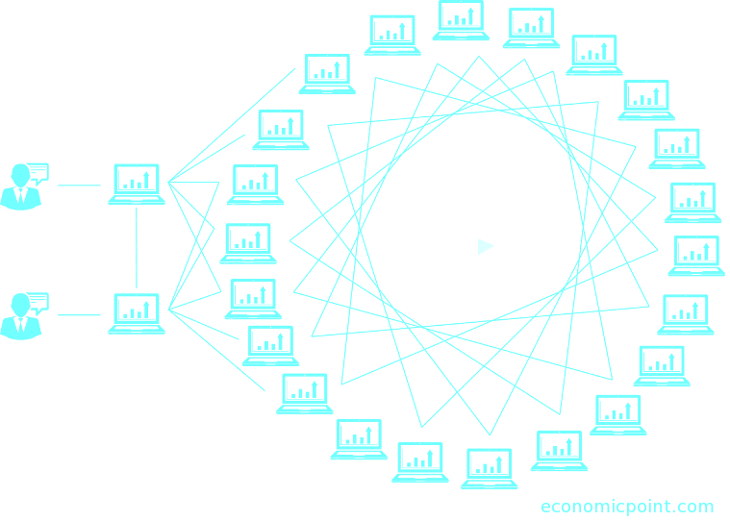
→ NODES
ETH
COPIES OF THE BLOCKCHAIN
ARE CONNECTED TO EACH OTHER
GOAL IS TO KEEP ALL COPIES EXACTLY THE SAME
ETH
Notes:
Need to explain consensus or consensus mechanism? Nodes don’t need to solve hashing problems - miners do.

Slide 37

WHAT CAN YOU STORE ON THE BLOCKCHAIN?
SMALL FILES
ADDRESSES
LARGE FILES
HASHES (of…)
SMART CONTRACTS
SPEEDY WRITES
Notes:
Each block needs to get certified as the right next block and then the rest of the nodes can copy it.
This certification / FINGERPRINTing is the MINING
BLOCKCHAIN are good for storing small bits of info that need to be:
Small files (<50kb)
A hash of a song / art piece
Wallet Addresses (hashes)
A smart contract

Slide 38
HASHES
DEMO HASHING
https://passwordsgenerator.net/sha256-hash-generator/
https://andersbrownworth.com/blockchain/hash
DEMO IPFS
See the different hashes

Slide 39


SECURITY OF THE CONTENT STORED IN THE BLOCKCHAIN
Not Anonymous
Pseudo Anonymous
WEB2
“You cannot come into my house, but what is inside can be stolen”
WEB3
“You can come into my house, but what is inside can not be stolen”
Notes:
NOT ANONYMOUS → The data inside have IDs (they belong to identities)
PSEUDO ANONYMOUS → The data inside belongs to addresses

Slide 40

APPS VS DAPPS
WEB2 APP
Storage
Metadata
Ledger
Private Sphere:
decisions made by Aggregator
APP
(Aggregator)
Data (ID, Meta)
Fees
Content Value
Data (ID, Meta)
Premium fees
%
CREATOR
AUDIENCE
Notes:
Aggregator the middleman - is in control

Slide 41



APPS VS DAPPS
WEB3 DAPP
storage
Public Sphere:
computation by Smart Contract
Block
chain
storage
IPFS
storage
IPFS
storage
Block
chain
DAPP
DAPP
Public ID / Signature
Network Fees / Price
Content Value
CREATOR
ETH
AUDIENCE
Notes:
The rules of the smart contract dictate who is in control
Funds can be sent from audience directly to the creator - or from audience to creator via the smart contract.
What could be the Architecture of BLOCKCHAIN based music app?
BLOCKCHAIN-> consensus over content
IPFS -> storage of content
ROYALTIES can be managed via: DividendContracts, UJODapp, MicroPayments, Patrons (Adv)
Spotify decides the value of a stream
On blockchain -> you can sell license,
If I have IPFS hash - then
Or centralize storage
DISCUSSION: what could be model of a web3 music app

Slide 42


Example of Architecture of a Music DApp
AUDIENCE
Browse the Dapp
storage
Block
chain
storage
CREATOR
IPFS
Dapp explores the blockchain
SONG
Dapp delivers content
storage
IPFS
storage
Block
chain
User can interact with Smart Contract
DAPP
Interaction is stored on the blockchain
Notes:
Putting the pieces together -
BLOCKCHAIN -> consensus over content
IPFS -> storage of content
ROYALTIES can be managed via: DividendContracts, UJODapp(SHOW), MicroPayments, Patrons (Adv)

Slide 43
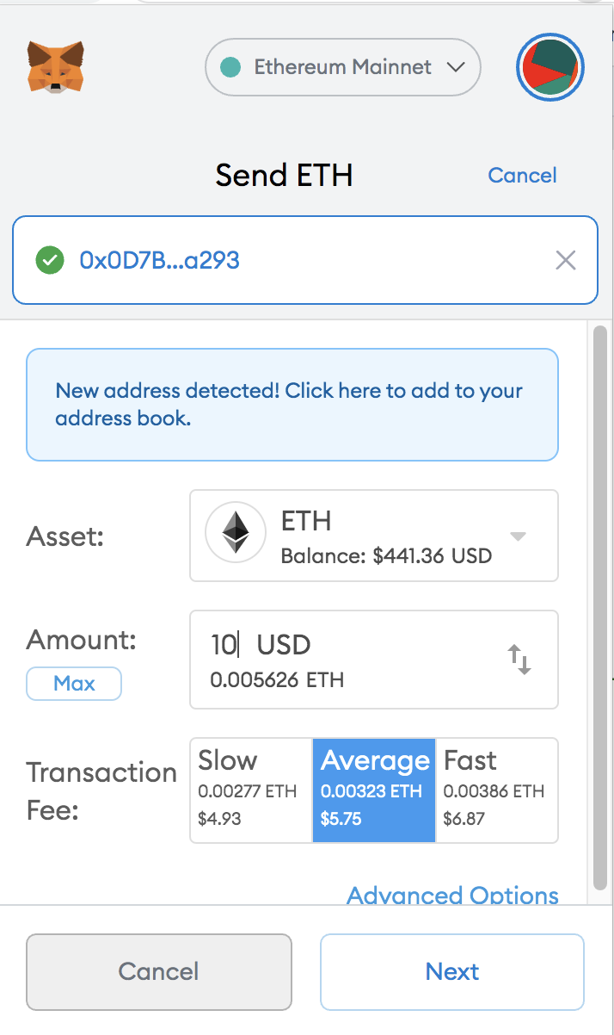
→ ETHER
(ETH)
NATIVE TOKEN OF THE ETHEREUM BLOCKCHAIN
SAVING INFORMATION COSTS ETH
COMPUTING COSTS ETH
MINTING TOKENS
ARITHMETIC
WHY ETHEREUM USES ETHER
SAFETY AND INCENTIVE TO MINE BLOCKS
EXPRESSED IN “GAS”
GAS UNIT (a way of pricing operations on the ethereum relative to each other)
GAS PRICE (depending how busy is the network)
GAS AMOUNT (depends on how complicated is the function)
GAS & TRANSACTIONS GETS MORE EXPENSIVE WHEN THE NETWORK IS BUSY
INVESTMENT
Notes:
SAFETY - stops people from guessing your password - because it is too expensive. Forces the code to be efficient.
“GAS” - A UNIT TO MEASURE COMPARATIVE COMPLEXITY
MINING

Slide 44

→ ADDRESSES
0x31f3733FF3CAe3E9c58D6100819D61Bea991CDA2
A Human (probably)
AKA - Externally Owned Address (EOA)
0xd65cb247e2387b1c817433c5e1e74166bb31774e
Smart Contracts

Slide 45

→ SMART CONTRACTS
Example 1: Saving small things
I am a shepherd
I have 10 sheep with collars on their necks and with their names on their collars.
I want to save their name in a list and put it on the blockchain so that there is a public record of who is the owner.
WHY ON THE BLOCKCHAIN
If I registered them with the city, I would have to trust the city’s record keeper & their servers.
RULES
If I eat a sheep, I want to remove it from my list. But I want to be the only one who can remove it.
Fluffy
0x05854cA140caB11e2f5AAb284c6AB5415f96E26B
Bob the Shepherd
Notes:
Why trust the record keeper? -
Why trust state’s computers?
A smart contract is a small program that organizes stuff according to a set of rules if then statements
If I am the owner then I can delete a sheep.
If the sheep is being saved to a smart contract that associates the sheep with me - what needs to be on its collar?
Just “Fluffy”? Or Fluffy & my eth addr? Or Fluffy, my eth addr and the dapp url?
If the sheep is an NFT, then the token contract will have its owner.
Why not save this on my own database or the cities leger of sheeps & shephards?
Stuff can be saved on blockchain
Connections between stuff in real life (IRL) & blockchain
Fluffy examp

Slide 46
→ SMART CONTRACTS
Example 2: Programmable Voting
VOTING RULES:
When can people vote
Who can vote
RECORDING VOTES
A candidate / proposal declared the winner
PROGRAMMABLE: “IF… THEN...”
A proposal has passed and something can be triggered.
Direct implementation of what you have voted for
Notes:
Online voting is tricky because:
You want it to be sure only qualified people vote
You want votes to be anonymous
You want voters to be able to prove to themselves that their vote was counted
You want to make their vote private.
Do you trust the state - which can have an interest in the outcome - to count your vote?

Slide 47
VOTING EXERCISE:
QUESTION?
How to add token 0x to Metamask
Go to snapshot page
vote
Notes:
BLOCKCHAIN -> consensus over content
IPFS -> storage of content
ROYALTIES can be managed via: DividendContracts, UJODapp, MicroPayments, Patrons (Adv)

Slide 48
→. SMART CONTRACTS
Example 3: Programmable Money
SMART CONTRACTS CAN HOLD MONEY
Some contract types:
DIVIDENDS: RULES SPLITTING UP REVENUES
ESCROW PAYMENTS: RULES FOR WHEN TO RELEASE THE MONEY
MULTI SIGNATURE WALLETS: RULES FOR HOW MANY VOTES ARE NEEDED TO SEND MONEY
Matteo, Rob, & Iuri own some money together. Each of us have an Ethereum Address. The money that we own together is sitting in the MultiSignature Wallet’s Smart Contract. In order to send some of our money to someone else, at least 2 of us need to agree to the transaction.
Notes:
To split up the royalties or dividends of a song
To hold money until something happens - which is like ebay.
To have a way for people to own money together

Slide 49
→ SMART CONTRACTS
Examples 4: Organizations
DAO: Decentralized Autonomous Organizations
Wallet
Voting
Payments
Rules / Governance
https://alchemy.daostack.io/dao/0x2b8c70fffda7f3d7667f7cfede1429313886329c
https://client.aragon.org/#/ethtraderdao.eth/
Matteo, Rob, & Iuri own some money together. Each of us have an Ethereum Address. The money that we own together is sitting in the MultiSignature Wallet’s Smart Contract. In order to send some of our money to someone else, at least 2 of us need to agree to the transaction.
Notes:
Oracles

Slide 50
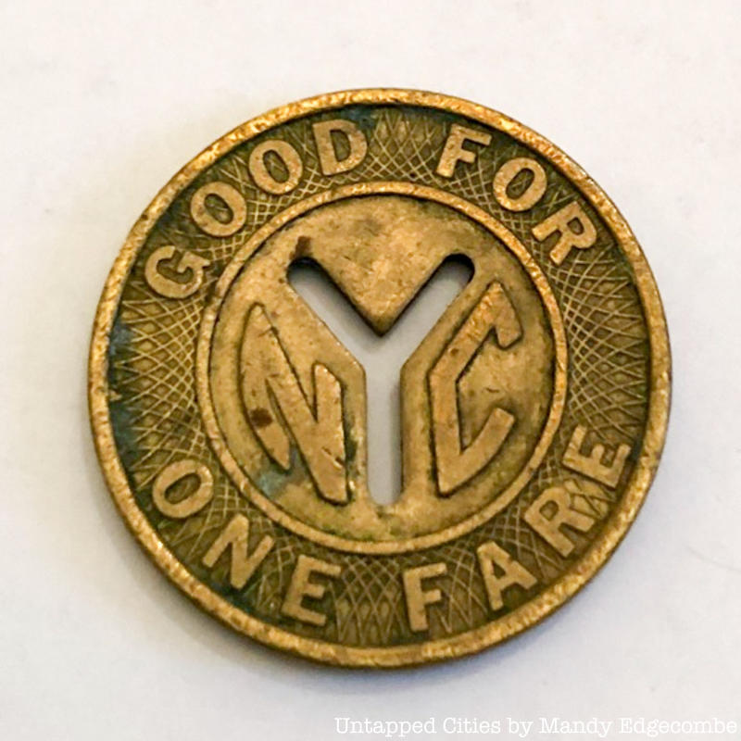
→ TOKENS
TOKEN
1) a thing serving as a visible or tangible representation of a fact, quality, feeling, etc.
2) a voucher that can be exchanged for goods or services, typically one given as a gift or forming part of a promotional offer
3) sometimes the token operates certain machines (laundry, arcade games, car wash etc)
Notes:
Caramelle as change when there were not enough 1 lira pieces ( I think)
https://www.bloomberg.com/news/articles/2019-06-15/italy-s-mafia-uses-the-old-lira-as-its-own-parallel-currency
Subway tokens
Frequent flier points
In the case of freq flier points there is a list of how many points all members have.
If I transfer some to my family ( following the freq flier rules - it takes them out of my account and into the family members account.
If I transfer money to you electronically - it works the same.
Disneyland token
Laundry token
Pinball token
Brixton Pound

Slide 51



→ TOKENS
ERC20 - make your own token
ERC20 FUNGIBLE TOKEN
Token Standard: predictability & interoperability
Lists of Value Holders’ Addresses
(good for governance)
They are “fungible” and “swappable”
ERC777 is the updated version of the ERC20
Notes:
Parallel local currency
Tomato token example
Similar to the Brixton pound
Community organzing & economics
Compensation chamber
Why should I get in debt to my bank to pay you if we live in the same local economic circuit?
I Sell veg, you are a carpenter - I need to borrow from bank
Or I can issue credit of vegetables that you can then use.

Slide 52




→ TOKENS
LOCAL CURRENCIES
COMPENSATION CHAMBERS
Sardex (ITA)
Brixton Pound (UK)
Monnaies Locales (FR)
BANK
GROCERY SHOP
HARDWARE
STORE
Notes:
Parallel local currency
Tomato token example
Similar to the Brixton pound
Community organzing & economics
Compensation chamber
Why should I get in debt to my bank to pay you if we live in the same local economic circuit?
I Sell veg, you are a carpenter - I need to borrow from bank
Or I can issue credit of vegetables that you can then use.
Make veg diagram

Slide 53
QUESTION:
Why in your opinion would organisations use ERC20 instead of ETH?
Matteo, Rob, & Iuri own some money together. Each of us have an Ethereum Address. The money that we own together is sitting in the MultiSignature Wallet’s Smart Contract. In order to send some of our money to someone else, at least 2 of us need to agree to the transaction.

Slide 54
→ TOKENS
NFTs (ERC721)
ERC721 NON FUNGIBLE TOKEN (NFT)
Each token is unique
The token can represent ownership of copyrights / royalties / licenses / kudos that the Author associated with the NFT
The Author can receive royalties every time the NFT is sold on the secondary market
Semi-fungible tokens
QUESTION: What does it mean to own a digital thing?
Who owns it
NFT
Digital asset it corresponds to on IPFS
Rules: eg: like 10% of resales go to original creator

Slide 55
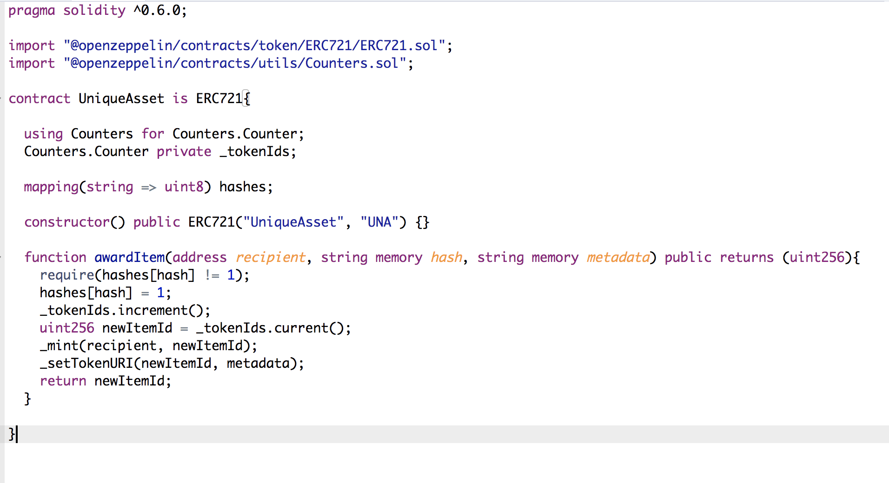
→ TOKENS
NFTs (ERC721)
SCREENSHOT OF RELEVANT PIECE OF CONTRACT FOR UNDERSTANDING
THE DNA OF AN NFT
Notes:
Then Demo of uploading to IPFS
https://pinata.cloud/pinmanager

Slide 56
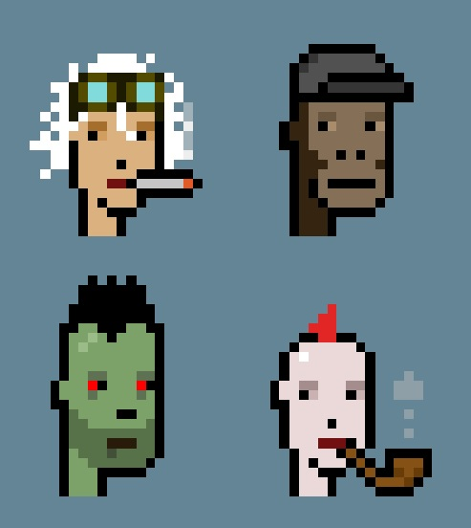
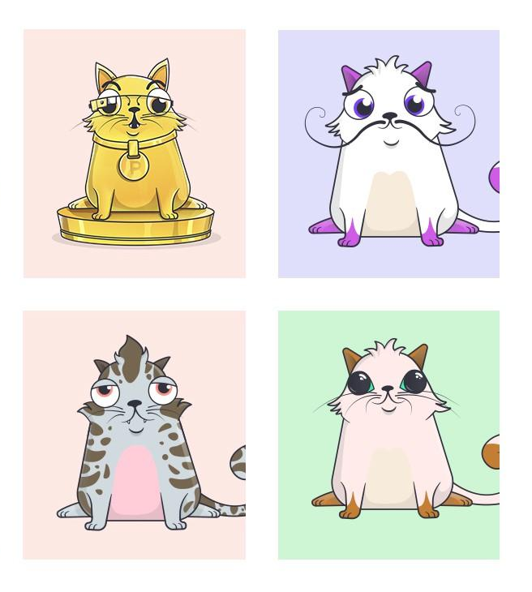
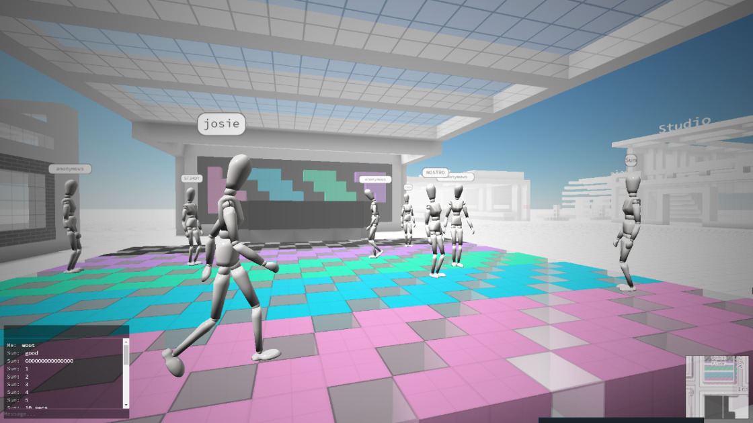

→ TOKENS
NFTs (ERC721)
Precedents
John Cage ‘owning’ 4’33” of silence
Naming a star in the sky as a kind of ownership
Owning the Brooklyn Bridge or a stake of the moon and reselling it
Crypto Kitties
Crypto Zombies
Crypto Punks
Cryptovoxels (the Metaverse)
Notes:
What does it mean to own a digital thing?
What does it mean to compose silence or display a upside down urinal and call it art and claim ownership?
Or on the scammy side - selling stakes in the moon? Its only worth the paper is printed on - but that paper can be imbued with value.

Slide 57
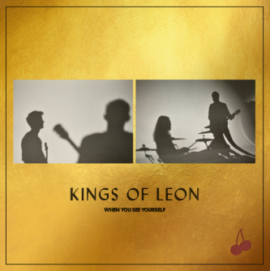
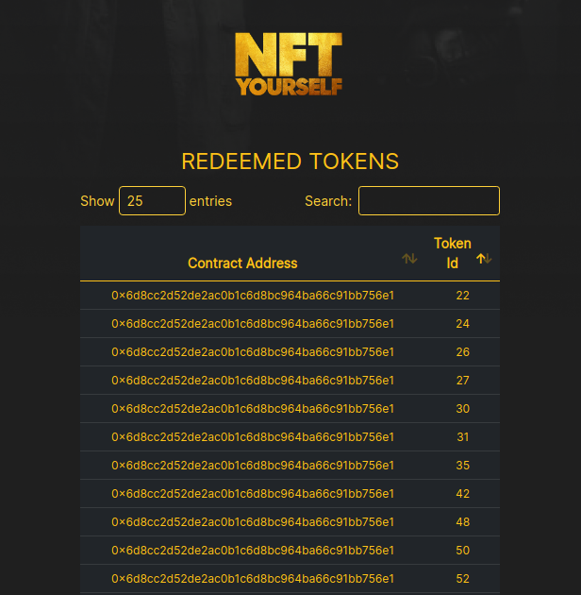
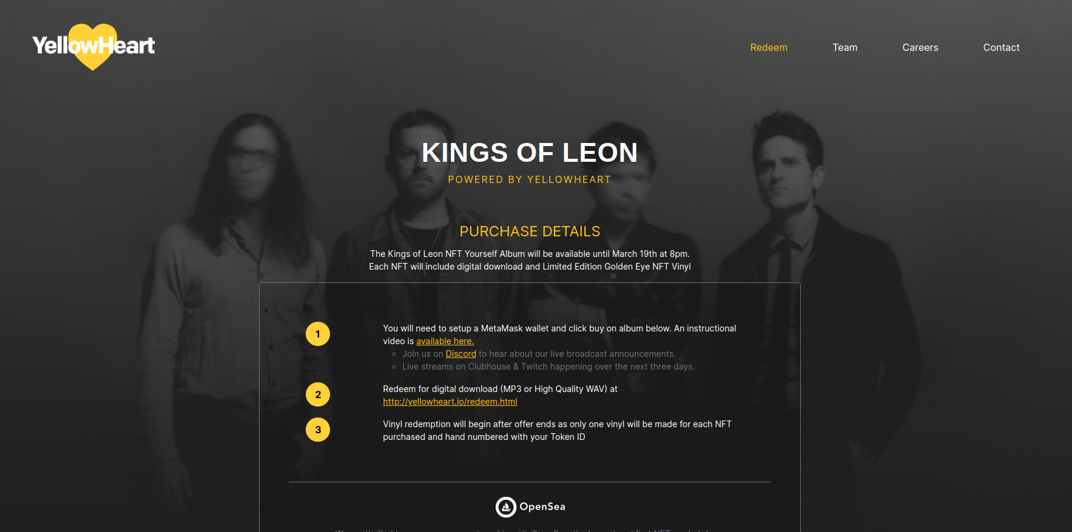
→ TOKENS
NFTs: KINGS OF LEON
WHAT IS THE SALE ABOUT
WHAT ARE THEY CREATING (WHITE LISTS)
Notes:
Kings of Leon example:
Purchasers of the 'NFT Yourself Album Edition' will receive:
One full digital album download
One Limited Edition Golden Eye Vinyl (physical copy)
One NFT collectible album artwork
NFT collectible with all proceeds benefiting Live Nation’s Crew Nation Fund.

Slide 58
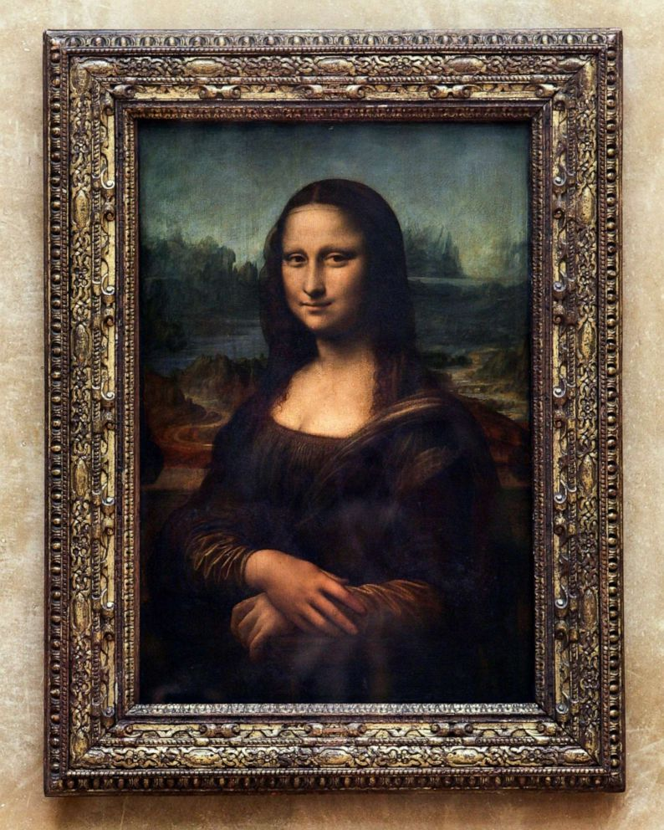

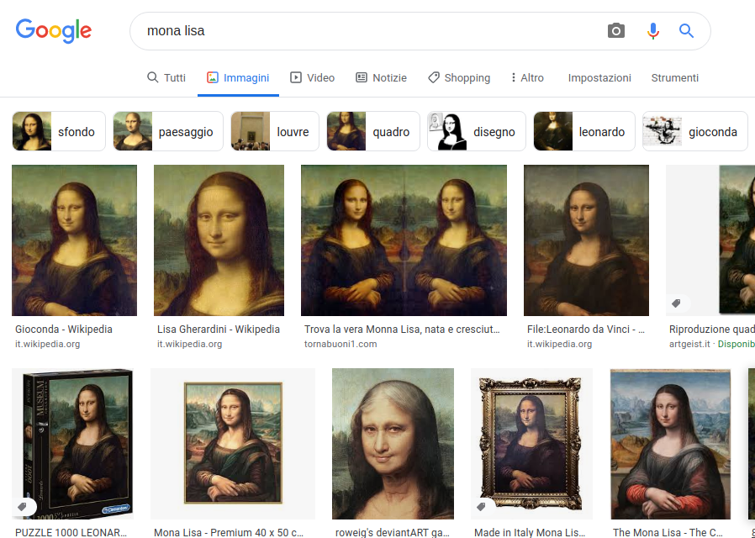
→ NFTs
NFTs: OWNERSHIP
PHYSICAL
PUBLIC & DIGITAL
NFT ON PUBLIC REGISTRY
Notes:
This is in the public domain but is owned by the owner of the token?
PHYSICAL and NFT are BOTH direct products of the artist, not copies or pics.
With the NFT, the Artist stored the original on IPFS as unlockable content (only the owner has it) → GOOGLE CANNOT SEE IT IF IT’s NOT SHARED

Slide 59
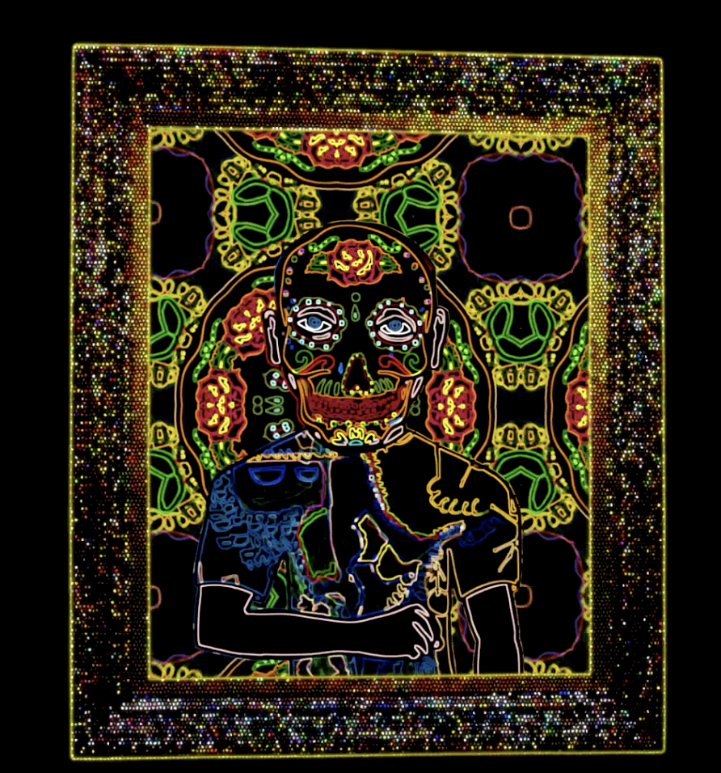
→ TOKENS
NFTs: OWNERSHIP
https://rarible.com/token/0x60f80121c31a0d46b5279700f9df786054aa5ee5:119260:0xc1202b2da243467882439944885339f9fd71279c
What does it mean to own a digital thing that is available on the internet?
Viewing the file on your computer is irrelevant
Possession of the file on your computer is irrelevant
The certificate of ownership - the ERC721 is divorced from the digital file.
The physical item and the listing of ownership of that item are not the same.
But I can prove I own the physical item by bringing the ERC721 to someone
Ownership is regarded as a value by a community

Slide 60
ICOs & DEFI
ICO
An Initial Coin Offering is the crypto version of an IPO, a public sale where a given project sells part of its tokens (e.g. ERC20) for cryptocurrency (e.g. ETH).
The creator of the token is the tokens central banker - and needs to decide how many to create - and how to deal with inflation.
DEFI
Decentralized Finance allows people to exchange, convert and invest crypto tokens into blockchain projects without the need to trust an intermediary exchange, banking system or institution.
A smart contract manages the exchange rate and interest rate.
Notes:
BLOCKCHAIN -> consensus over content
IPFS -> storage of content
ROYALTIES can be managed via: DividendContracts, UJODapp, MicroPayments, Patrons (Adv)

Slide 61
LAYER 2 (L2)
Layer1 is the Ethereum Blockchain
Layer2 is a solution to operate on the Ethereum blockchain in a cheaper,
faster and more scalable way
Eg: Make 1000 txns on one of the L2 chains and the L2 chain reports back a single txn on the main L1 chain. L2 solutions rely on the main chain for security.
See the links to the xDai network (and it’s cheap gas fees)
Notes:
BLOCKCHAIN -> consensus over content
IPFS -> storage of content
ROYALTIES can be managed via: DividendContracts, UJODapp, MicroPayments, Patrons (Adv)

Slide 62
BREAKOUT ASSIGNMENT
How would you organize an on-chain Fanclub?
Notes:
Groups of two
5-10 mins

Slide 63
ARE YOU STILL THERE? :)
Notes:
NOT ANONYMOUS → The data inside have IDs (they belong to identities)
PSEUDO ANONYMOUS → The data inside belongs to addresses

Slide 64
QUESTION TIME

Slide 65
ASSIGNMENT:
PREPARE A MUSIC RELEASE PLAN ON ETHEREUM
DO SOME TUTORIAL
Groups of 2
Use Discord Breakout rooms
Max 5 slides
What kind of audio/song/piece? How does music evolve?
Take some Remix tutorial
try deploy a test ERC721 or ERC20
Notes:
Putting the pieces together -
BLOCKCHAIN -> consensus over content
IPFS -> storage of content
ROYALTIES can be managed via: DividendContracts, UJODapp, MicroPayments, Patrons (Adv)

Slide 66
DApps & Examples
A smart contract with a Front End
DApp examples
https://www.stateofthedapps.com/
https://dappradar.com/rankings/category/collectibles
https://www.cryptoarte.io/paintings/9890
https://www.thehashmasks.com/
https://dapplist.cointelegraph.com/
https://consensys.net/blog/news/90-ethereum-apps-you-can-use-right-now/
https://ethereum.org/en/dapps/
https://da.ps
https://uniswap.org
https://sablier.finance
https://explorer.livepeer.org
https://pooltogether.com
https://audius.co
Notes:
BLOCKCHAIN -> consensus over content
IPFS -> storage of content
ROYALTIES can be managed via: DividendContracts, UJODapp, MicroPayments, Patrons (Adv)

Slide 67
NFT MARKETPLACES
https://superrare.co/
https://rarible.com/
https://opensea.io/
Notes:
BLOCKCHAIN -> consensus over content
IPFS -> storage of content
ROYALTIES can be managed via: DividendContracts, UJODapp, MicroPayments, Patrons (Adv)

Slide 68
Interesting Links
hash generator
https://passwordsgenerator.net/sha256-hash-generator/
https://brixtonpound.org/
anders blockchain videos & demos
https://andersbrownworth.com/blockchain/
http://erc721.org/
xDai chain -
https://www.xdaichain.com/about-xdai/use-cases/
https://www.xdaichain.com/about-xdai/use-cases/community-currencies
about NFT
https://mashable.com/article/what-is-an-nft-non-fungible-token/
nifty.ink
https://www.youtube.com/watch?v=XtO6k9egpPk
https://twitter.com/azacharyf/status/1371787981380587521
Notes:
BLOCKCHAIN -> consensus over content
IPFS -> storage of content
ROYALTIES can be managed via: DividendContracts, UJODapp, MicroPayments, Patrons (Adv)

Slide 69
Very Interesting Links
Remix
https://remix.ethereum.org
Learneth
https://remix.ethereum.org/?#activate=udapp,solidity,LearnEth
Remix Intro
https://www.youtube.com/channel/UCjTUPyFEr2xDGN6Cg8nKDaA
A history of NFT’s
https://twitter.com/simondlr/status/1367677119673688065
Video NFT
https://rarible.com/token/0xd07dc4262bcdbf85190c01c996b4c06a461d2430:318695:0xc1202b2da243467882439944885339f9fd71279c
https://rarible.com/token/0x60f80121c31a0d46b5279700f9df786054aa5ee5:119260:0xc1202b2da243467882439944885339f9fd71279c
Links I couldn’t put on the previous page
Notes:
BLOCKCHAIN -> consensus over content
IPFS -> storage of content
ROYALTIES can be managed via: DividendContracts, UJODapp, MicroPayments, Patrons (Adv)

Slide 70
HOMEWORK
MOD 1 END.

